Slide 1
Python startup
2015.04.12

Slide 2
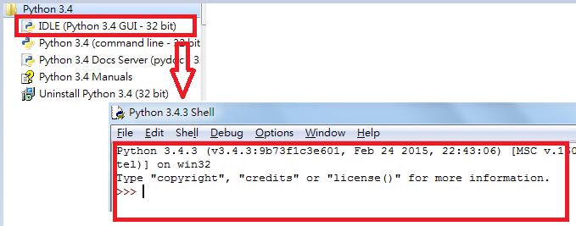
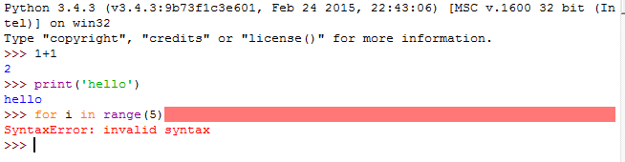
Python shell- IDLE
Test environment:
command
loop

Slide 3
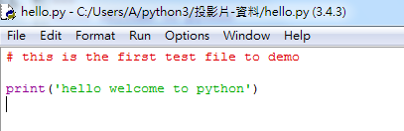
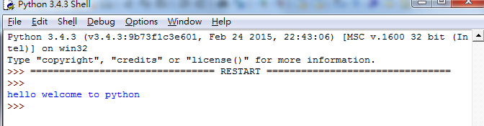
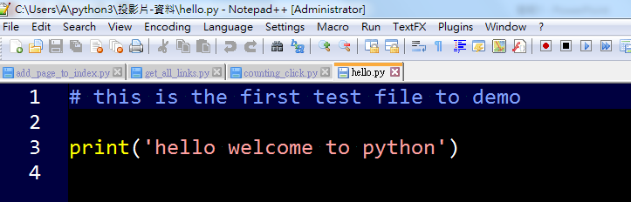

Python text editor
F5
Python IDLE
2) Text editor: eg. notepad++
→ Python command line

Slide 4



#1 Data type
String
String
Numeric
Int, float, long, complex
sequence
List, tuple, dictionary

Slide 5
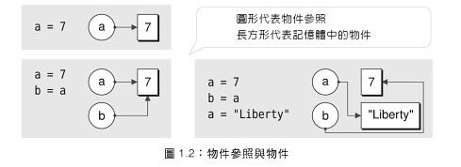
#2 Object reference

Slide 6




#3 Collection data types
List element can be changed
list
tuple
Tuple element can’t be modified

Slide 7
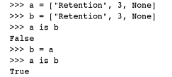

#4 Logic operator
identity
membership

Slide 8
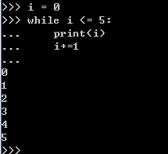
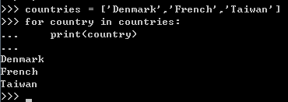
#5 loop
for
while

Slide 9
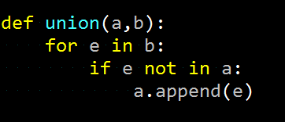
#6 function (def)

Slide 10
Homework
Given the variables s and t defined as:
s = ‘do’
t = ‘exercise’
Try to print out “do exercise”. (without using quote)
Try to check an (n by n) matrix is antisymmetric
Try to check identity matrix

